Slide 1
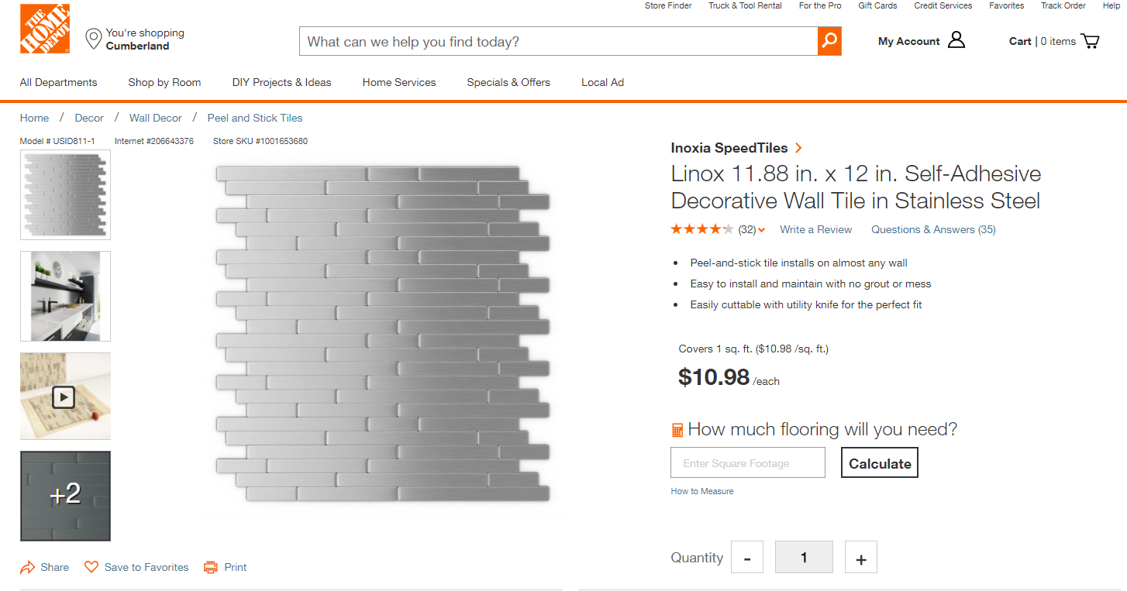
Determining the JLQ Value and Frequency
I am using as an example SKU = 1001653680 and STR = 2718
SKU | Store | Parm code | Parm Value | Eff Begin date | Eff End date | Param Desc | LAST_UPD_USR
1001653680 | 2718 | 1703 | 24 | 8/10/2018 | 9/1/2018 | JLQ FW 28 | DXK4457
I uploaded JLQ parm this week with a value of 24. Let’s see how I got there.

Slide 2
Determining the JLQ Value and Frequency
I am starting with sales transactions over the last 52 weeks
Sales transactional data for every SKU/STR is grouped by Fiscal Week, POS_RGSTR_ID and quantity of the sold SKU.
FW | POS_RGSTR_ID | UNT_QTY | GRP_QTY
FW201807 | 4 | 24 | 24
FW201807 | 5 | 1 | 1
FW201807 | 2 | 1 | 7
FW201807 | 2 | 1
FW201807 | 2 | 1
FW201807 | 2 | 1
FW201807 | 2 | 1
FW201807 | 2 | 1
FW201807 | 2 | 1
Frequencies for different values get calculated

Slide 3
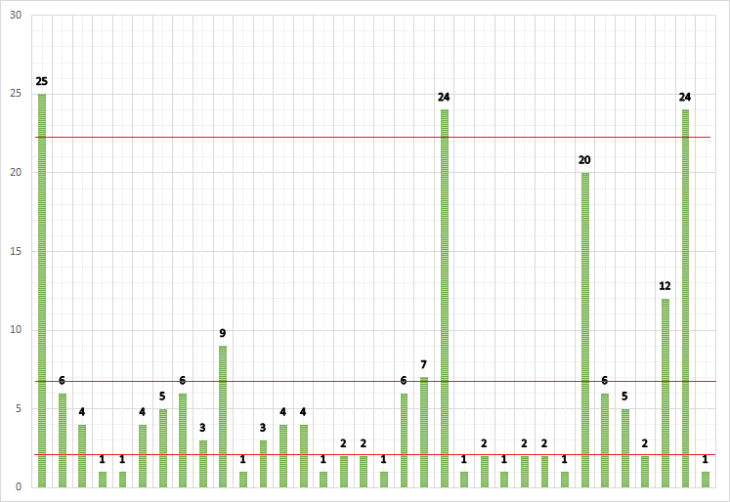
Determining the JLQ Value and Frequency
Next, the data is divided into three distinct groups
K-Means Clustering draws three lines of best fit through each group
The average of the cluster becomes the JLQ value, and its size becomes the frequency
23.25
6.89
2.05
SKU 1001653680 : 11.8X12 LINOX METAL SPEEDTILE - Store #2718
Clustering Result - Average JLQ: 23.25, Frequency: 4

Slide 4
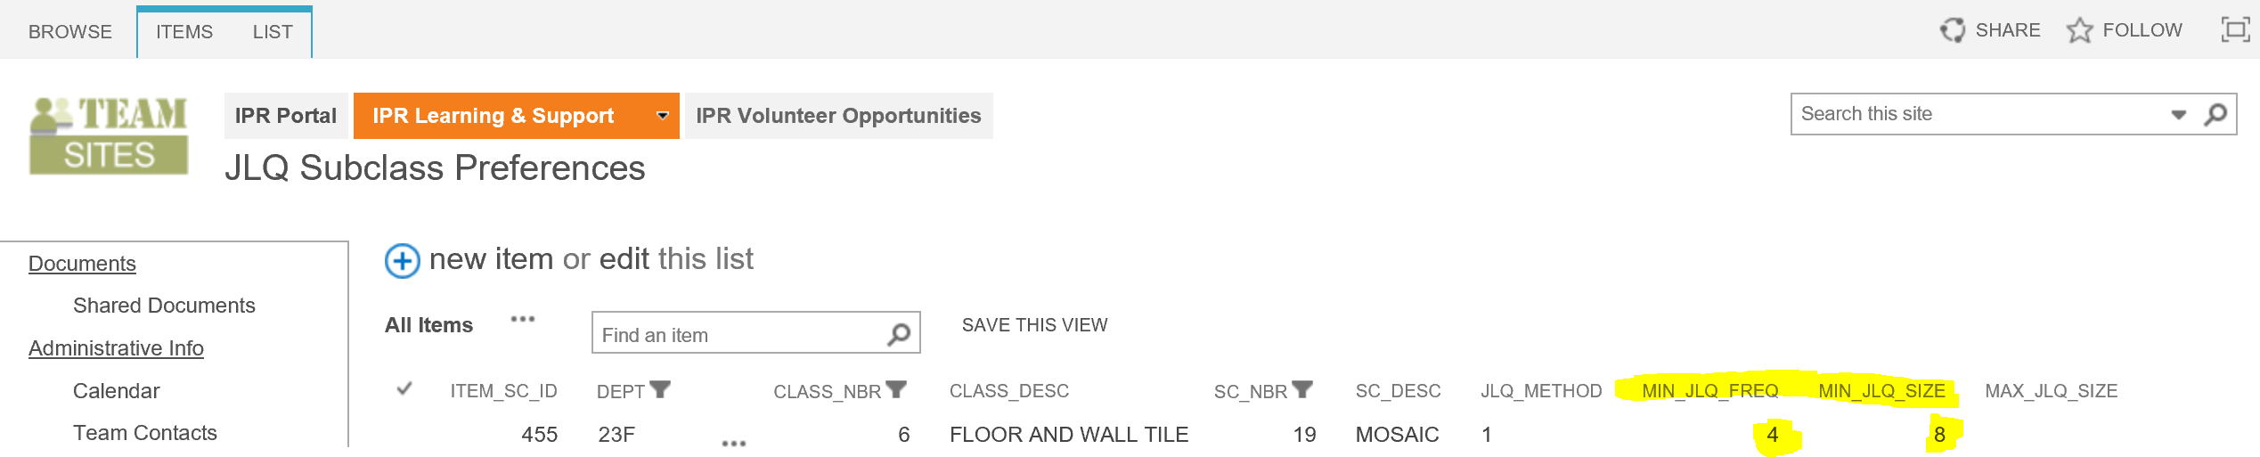
Determining the JLQ Value and Frequency
Next we are going to decide if our clusters meet the predetermined Minimum JLQ Frequency and Minimum JLQ Size
In this case it is set at 4 and 8

Slide 5
Leveraging the JLQ Parameters
Minimum JLQ Frequency
Minimum JLQ Size
How many times a year does a JLQ need to happen to make the inventory investment worthwhile?
How large does the JLQ size need to be to generate an MOHQ parameter?
SKU 1001653680 : 11.8X12 LINOX METAL SPEEDTILE - Store #2718
SKU 1001653680 : 11.8X12 LINOX METAL SPEEDTILE - Store #2718
JLQ frequency was set to 4 units:
The frequency in the top cluster is equal to 4, which complies with the preset Minimum JLQ Frequency.
JLQ size was set to 8 units:
The size of the top cluster is 24, which complies with the preset Minimum JLQ Size.

Slide 6
Options for JLQ Coverage
There are also a two options for JLQ depending on how conservative or aggressive we want our strategy to be
1 JLQ: Conservative baseline
Full JLQ: Store-SKU specific multiples of the job lot quantity (e.g. 2x or 3x), taking into account the variability within job sizes and the exact probability of selling multiple jobs within lead time

